Slide 1
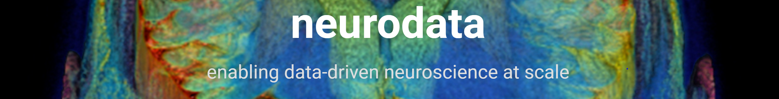
DARPA SIMPLEX Report Spatial Data: Management, Analysis, and Visualization
PI: Joshua Vogelstein
N66001-15-C-4041
Presented by: Randal Burns (co-PI), Alex Baden, Kunal Lillaney

Slide 2
Evolution from:
The OpenConnectome Project
The Sloan Digital Sky Survey
New Capabilities
Enhanced data models (histology, time-series, tensors)
Cloud data support
Visualization software
Notes:
Web-services categorized. Read and write spatial data.
Neuroscience ontology--to represent structures and their relationships. E.g., synapses, segments, neurons.
All volumetric and spatial queries build on this capabaility
Designed for computer vision, not biology. Is extensible.

Slide 3

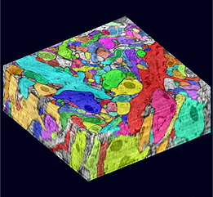
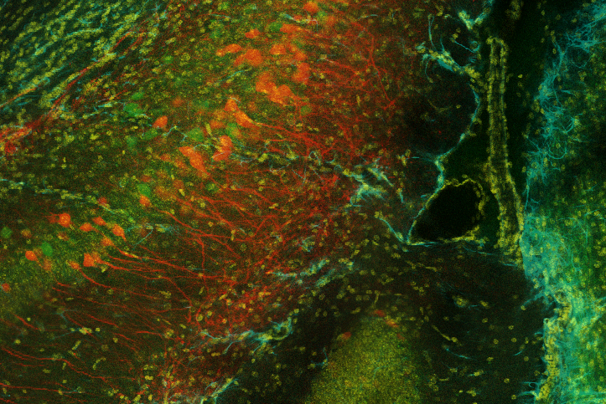
Open-science, data-intensive analysis of the brain
Peta-scale storage linked with HPC
Computational vision of brain structure
Spatial queries (clusters, volumes, distributions)

Slide 4


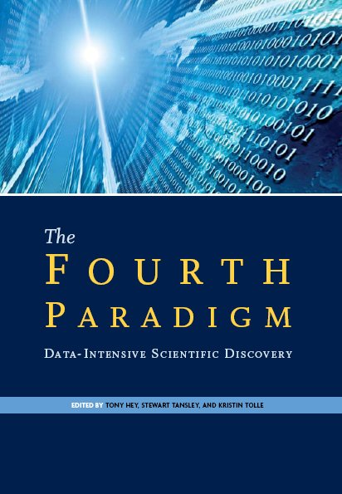
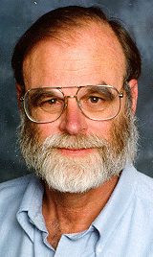
Data-intensive computing model for sharing
Share analysis tools as well as data
“Bring the computation to the data”
Goals:
Reproducibility of results
Variation/enhancement of previous
Data mining, feature extraction
Interactive data exploration

Slide 5
OCP Data Cluster Services
Cutout: extract dense spatial data restricted by dimensions and region
Mulitple spatially registered image and annotation projects
Annotate: Upload the spatial extent of a neuroscience object
Object database: Read/write metadata linked to annotations, e.g. query by synapse type.
Spatial queries (clustering, volume, distributions)
Building blocks for visualization, downloads, and statistical analysis
We do all our science in the open-science framework, i.e. anyone else has the tools to do the same
Data sharing is a read/write thing
Not just downloads, links, visualizations
Storage of derived data products, personal data spaces
Notes:
Web-services categorized. Read and write spatial data.
Neuroscience ontology--to represent structures and their relationships. E.g., synapses, segments, neurons.
All volumetric and spatial queries build on this capabaility
Designed for computer vision, not biology. Is extensible.

Slide 6
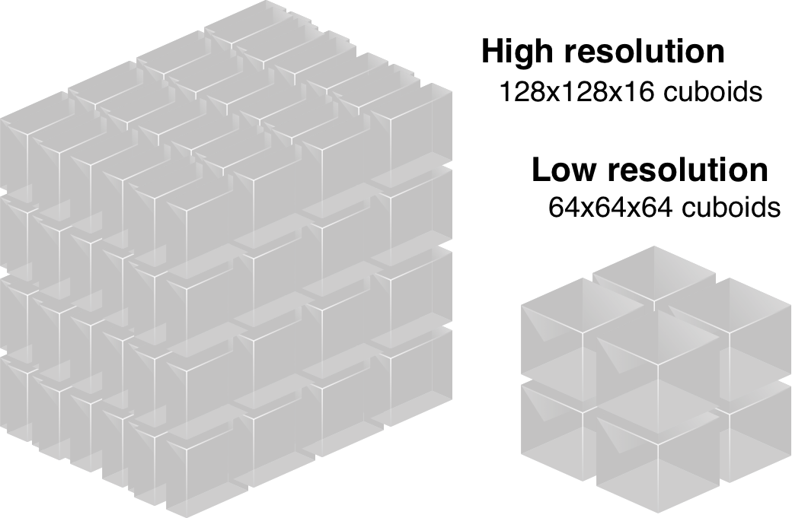
Spatial Data and Usage Patterns
Small regions of interest in massive data sets
Dynamic materializations of 2-d tiles
From 3-d or 4-d databases
Any (axis orthogonal) cutting plane

Slide 7
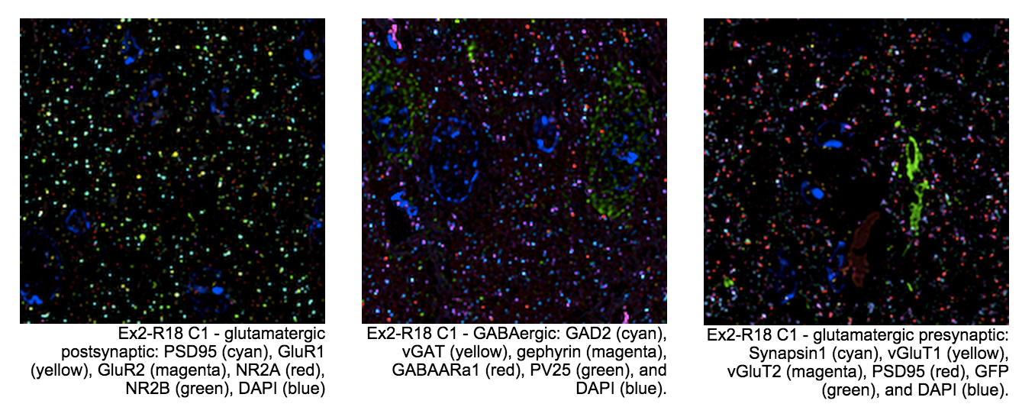
Spatial Data and Usage Patterns
Exponentially many combinations of channels from the same data set (flattened for performance)
Must push data to network edge AND must dynamically manage data contents (Caching)!

Slide 8
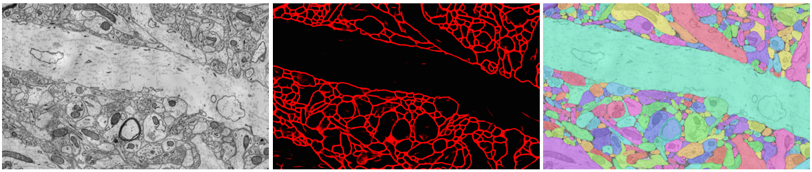
Eat your own dogfood
Use previous results to as bulding blocks for new results
(image) Validating deep-belief network membrane detection against data and manual annoations from the Lichtman lab
Use OCP to integrate disparate tools chains
E.g., ilastic and Rhoanna
All data and all analysis tasks by any user

Slide 9
Beyond OCP
More data types:
OpenSynaptome: multi-channel, co-registered
Optophysiology: time-series + 2d or 3d
Histology
Enriched data products
Graphs
Tractography
Skeletons
Minus open:
Reduce obstacles to participation
Visualization platform: NeuroDataVis
Cloud data support
Notes:
Web-services categorized. Read and write spatial data.
Neuroscience ontology--to represent structures and their relationships. E.g., synapses, segments, neurons.
All volumetric and spatial queries build on this capabaility
Designed for computer vision, not biology. Is extensible.

Slide 10
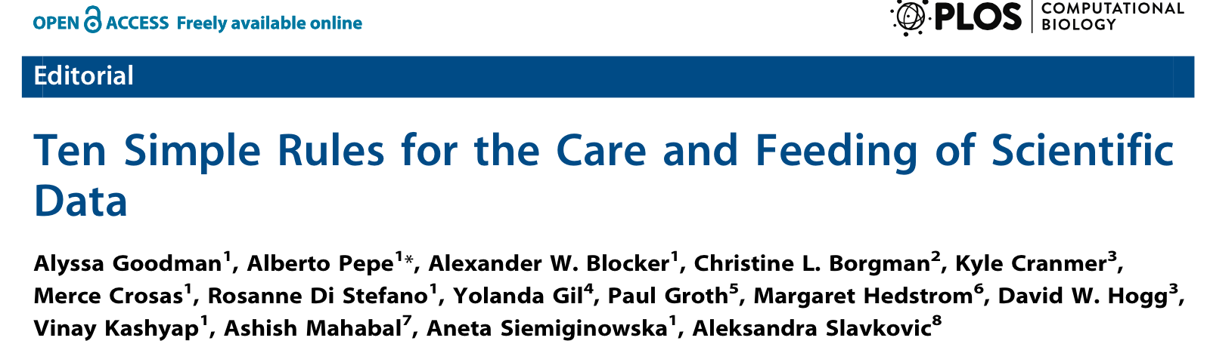
`
(2) Share your data online with a Permanent Identifier
We are a Nature Data repository, we provide DOIs for code and data
(3) Conduct science with a particular level of reuse in mind
(4) Publish Workflow as Context
Publish workflows/pipelines with data
(6) Publish your code, even the small bits
http://github.com/neurodata/
(7) State how you want to get credit
ODC-By: Attribution with unrestricted reuse, but credit to data creators, original publication and neurodata.io
Notes:
Web-services categorized. Read and write spatial data.
Neuroscience ontology--to represent structures and their relationships. E.g., synapses, segments, neurons.
All volumetric and spatial queries build on this capabaility
Designed for computer vision, not biology. Is extensible.

